Slide 1
Fake Gram
By Capstone Team #1
Noris Buriac, Phillip Fong, Yasir "Snowman" Karapinar, Athena Kozak, Edvin Lin
One App to rule them all, One App to find them, One App to bring them all, and in the darkness bind them.
Notes:
Heyo we're Capstone Team Numero Uno, represented by Athena, Edvin, Noris, Phillip, and Yasir.

Slide 2

synopsis
What is the point of this (great) application.
Why did we decide to bring this great app into existence.
Notes:
Synopsis of the app as well as this presentation.
We're going to go through the app as well our thought process, struggles, how we solved some of those struggles, and whatever else whilst we were creating with this app from beginning to end.
One of the most popular aspects of the internet is social media. Imagine being able to message people, to share your life, within seconds of posting something within an app for the whole world to see.
Little crazy to think about the fact that it wasn't so long ago that it was incredibly difficult to send a message to someone on the other side of the world, now we can do it in a matter of seconds.
Now because of social media becoming so popular and having such a strong influence on people's daily lives, we decided to create our own interpretation of a social media app.
This app will be image-based: think Instagram, which was/is a pioneer of social media and, I think, the most popular social media application in the world.
Obviously, we didn't create instagram in two weeks but instead we split our scope into two phases so this is more our Frankenstein.

Slide 3
Planning & Work Distribution
Sprint Planning
Azure DevOps
Taskboard management.
User Stories.
Notes:
In order to begin the initiation of this *great* app, we had to properly assign tasks, comprehend what needed to be completed, and most importantly, we had to find out where to start in our project; So we used this ancient technique known as a sprint plan meeting.
The sprint planning took us about 4 hours, including what we wanted to create, the requirements analysis for them, creating the tasks for it, and then assigning them.

Slide 4
First Phase
Register / Login
Follow / Unfollow other users
Create / Delete posts
Like / Unlike posts
Comment / Uncomment posts
Second Phase
Set user accounts private or public
Explore page
Notifications
Message/Chat
Stories
Search bar
Notes:
Phase 1 on top, this is a little high-level and there are some unsaid things such as a functional and aesthetic UI and whatnot, but this is the gist of our scope and requirements.
We knew we could get phase 1 complete, but phase 2 we had knew it would depend on how much time we had left.
Our time estimations were a little rocky due to not all of us knowing the technologies we wanted to use.

Slide 5
Tools
Azure DevOps & GitHub
Notes:
What did we use to achieve this?
We didn't integrate our GitHub repo with Azure DevOps due to incomplete commit issues so obviously Microsoft still has some work to do.
Overall I was quite impressed with Azure DevOps, it doesn't have much of a learning curve, Microsoft has solid documentation for every little feature and tidbit for it. It's solid.
User stories are a tool used in Agile, they're used to capture a description of a software feature from an end-user perspective. A user story helps to create a simplified description of a requirement.
I personally thought User Stories were done poorly in Azure DevOps in the sense that they're not very intuitive. When we were adding user stories I felt like we just adding a normal KanBan task, it felt like I was adding a parent task and adding child tasks to it basically.
SHOW AZURE DEVOPS

Slide 6
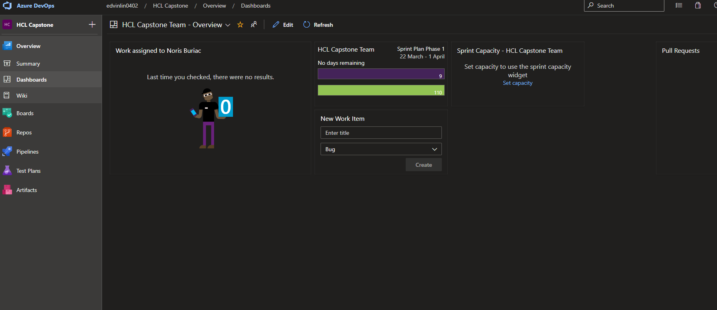
Azure Dashboard
Notes:
What you're greeted with.
Sort've like 'Widgets' on Android, can pick and choose what shows up on home screen.

Slide 7
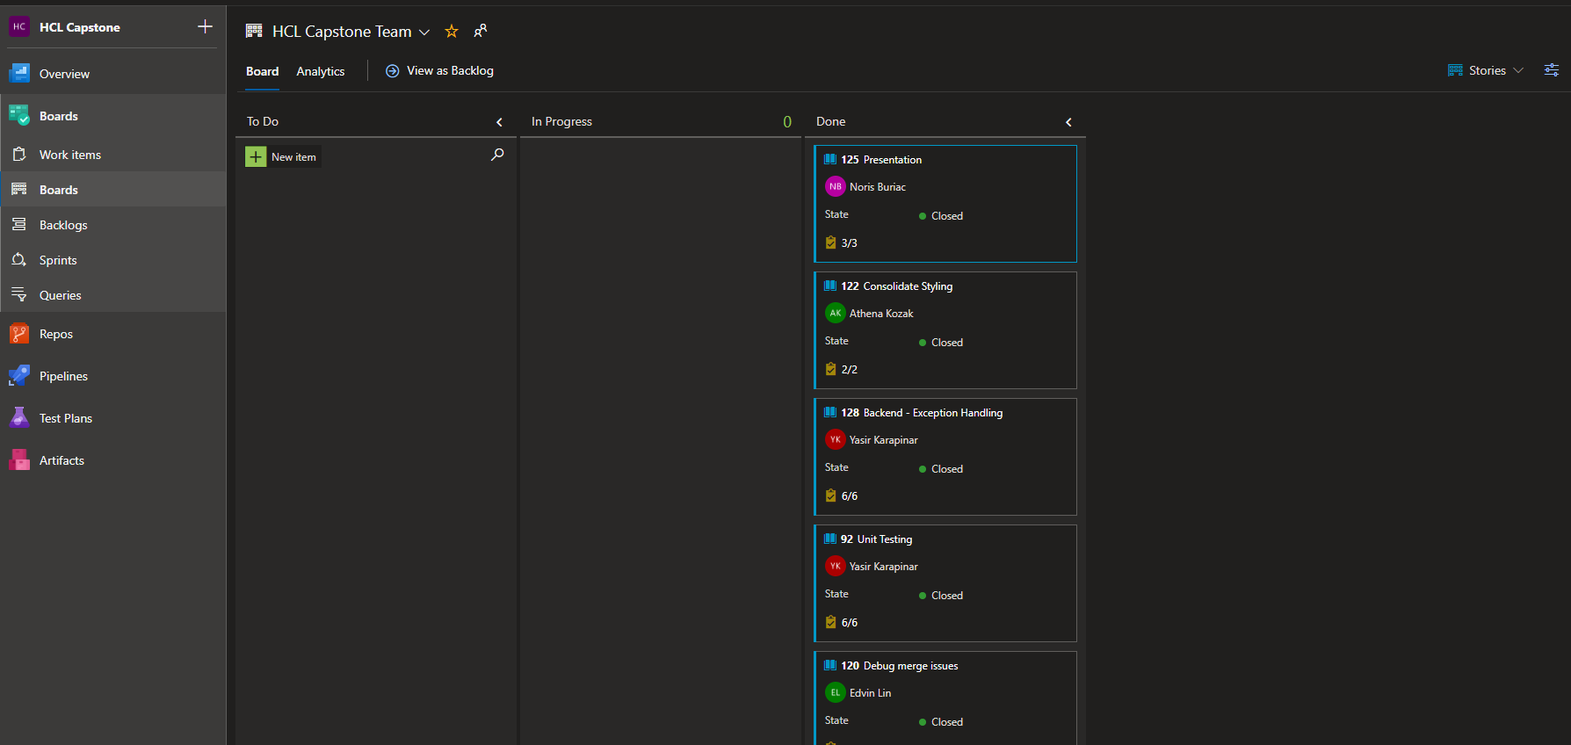
Taskboard

Slide 8
Design
Design choices and characteristics.
Clean and Simple UI
Easy and Intuitive UX
Notes:
We already had a pseudo-prototype ready going into this project so we had an idea about how we wanted to design this. Due to this extra bit of inspiration, and the fact that this was our own project, we didn't have a client or any stakeholders for that matter, we dodged doing CRC cards and instead went into requirement analysis and judging what we wanted and didn't want to do and basically appraised the scope of this project.

Slide 9
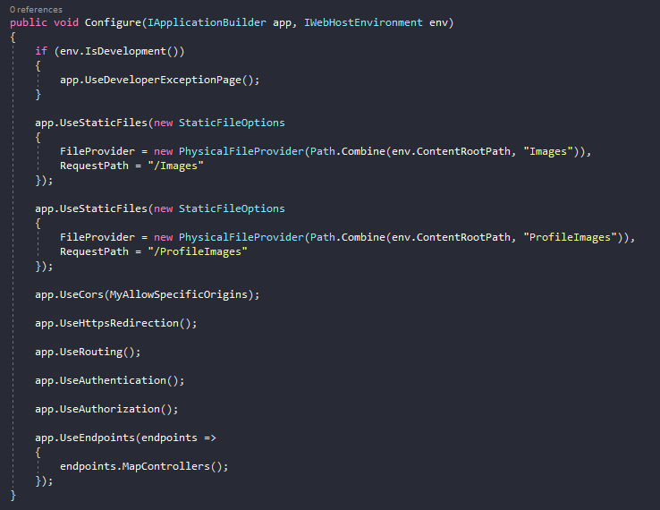
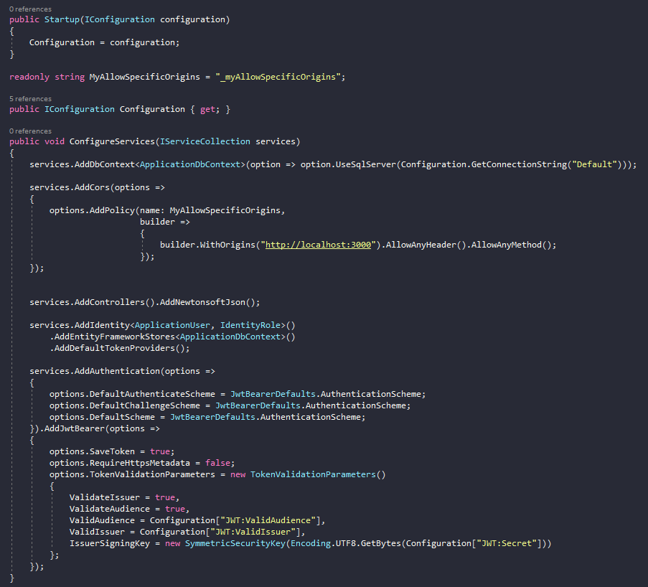
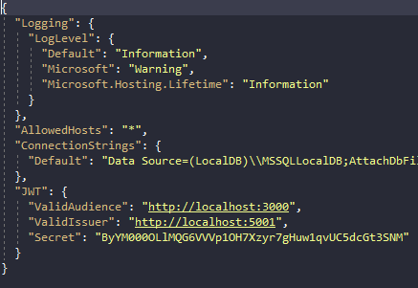
settings

Slide 10


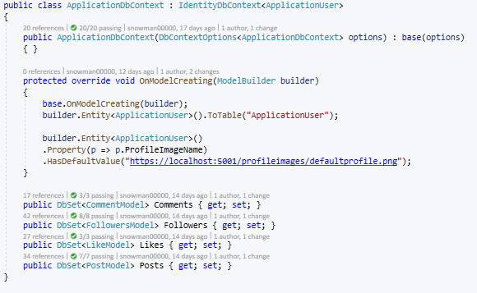
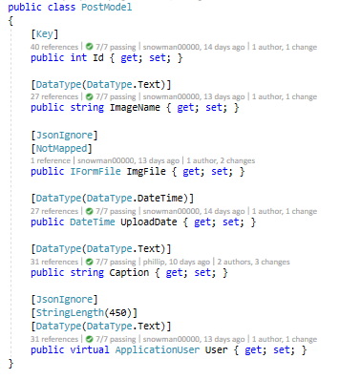
Database – Entity Framework

Slide 11
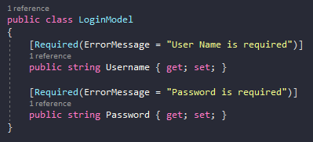
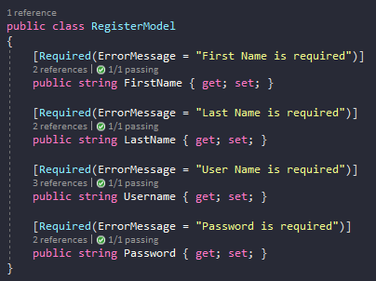
Authenticate controller
Register
Login

Slide 12
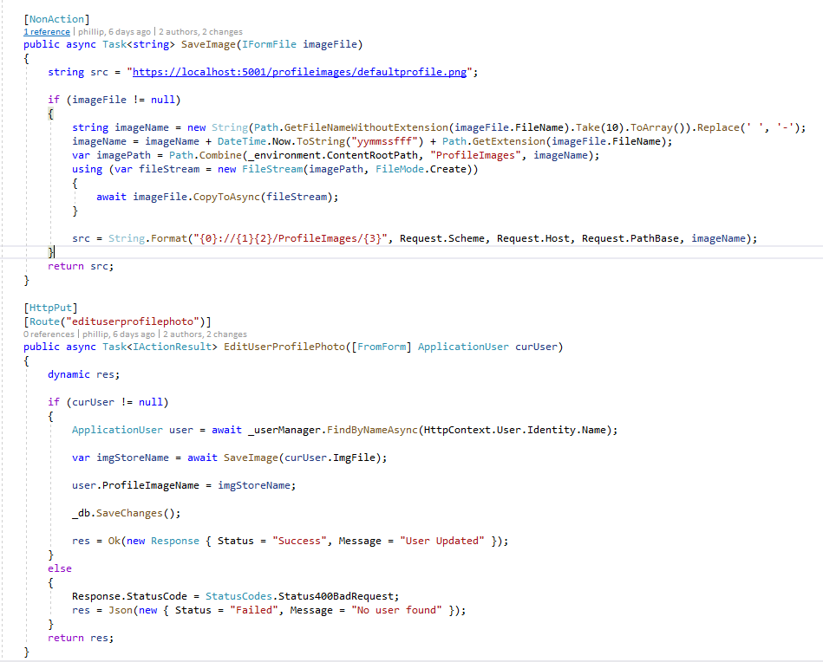
Controllers - Users
[NonAction]
Function can't be called on its own

Slide 13
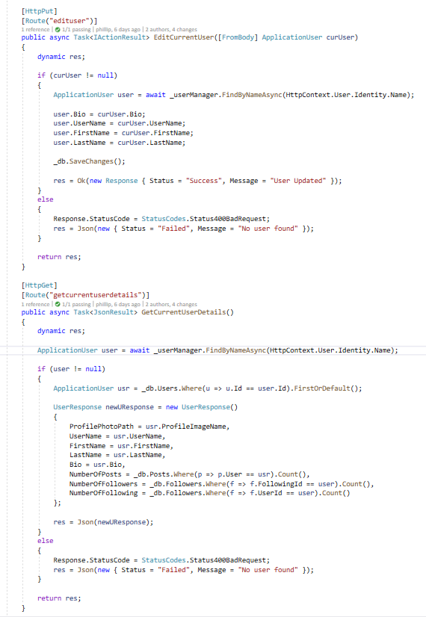
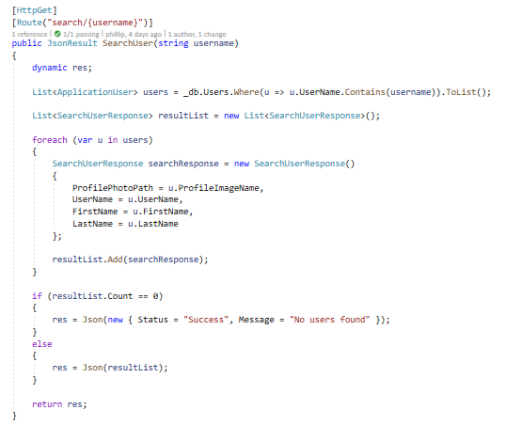
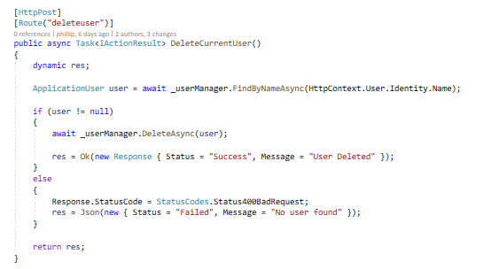
Edit user profile
Retrieve current user details, details of other users, delete current user, search for users

Slide 14
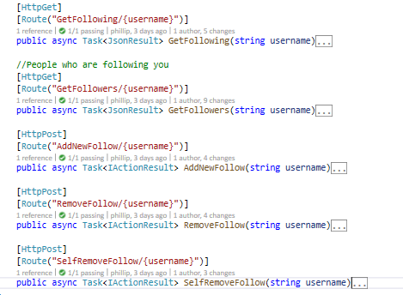
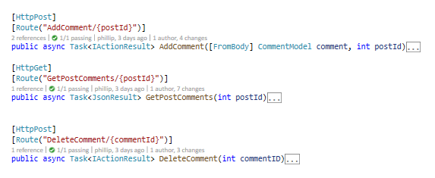
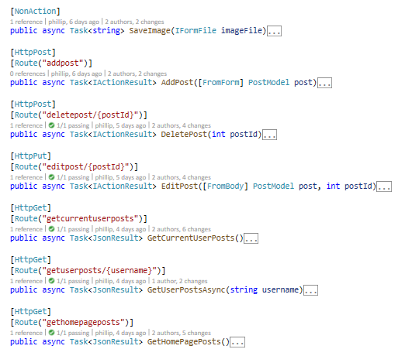
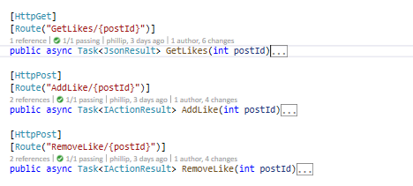
Followers, Post, Comment, Like

Slide 15
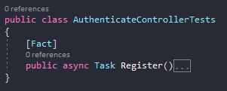
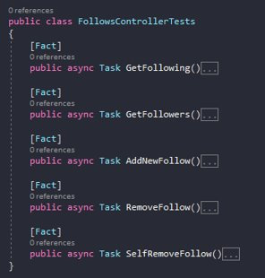
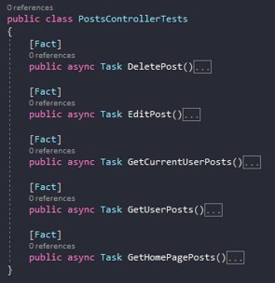
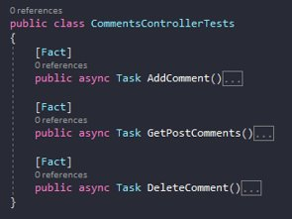
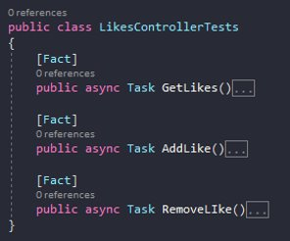
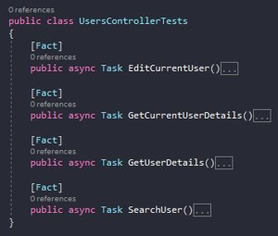
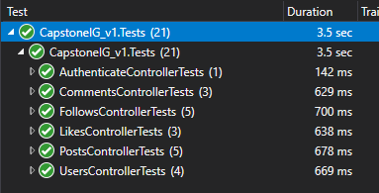
Unit tests

Slide 16
Questions

Slide 17
The End

